Slide 1

Heart Disease Prediction
TSP- AI ML Fundamentals (Capstone Project)
Presented By:
Name : S.MOTHAGAVASANTHAN
NM ID : au8100810021102022
College Name : University college of engineering, BIT CAMPUS, Anna university, Trichy.
Guided By: RAMAR

Slide 2
OUTLINE
Problem Statement (Should not include solution)
Proposed System/Solution
Algorithm & Deployment
GitHub Link
Project Demo(photos / videos)
Conclusion
Future Scope
References

Slide 3
Problem Statement
Problem Statement: Develop a predictive model for heart disease that can accurately classify whether a patient is likely to have heart disease based on various medical and demographic features.
Background: Heart disease is a leading cause of death worldwide, and its early detection is crucial for effective treatment and prevention. Predictive models can aid healthcare professionals in identifying individuals at high risk of heart disease, allowing for timely intervention and personalized care.
Objective: The objective of this project is to build a robust machine learning model capable of accurately predicting the likelihood of heart disease in individuals based on a set of input features such as age, gender, blood pressure, cholesterol levels, etc. The model should achieve high accuracy, sensitivity, and specificity in its predictions.
Data: The project will utilize a dataset containing records of patients, each characterized by several attributes including demographic information, medical history, and results of diagnostic tests. The dataset will be preprocessed to handle missing values, normalize features, and possibly perform feature engineering to enhance predictive performance.

Slide 4
Proposed Solution
Predicting heart disease is crucial for early intervention and prevention. One effective solution involves employing machine learning algorithms on comprehensive health data to create predictive models. Here's a proposed solution:
Data Collection.
Data Preprocessing
Feature Selection.
Model Selection.
Model Training.
Hyperparameter Tuning.
Model Evaluation.
Deployment.
Monitoring and Updating.
Ethical Considerations.

Slide 5
Algorithm & Deployment
There are several machine learning algorithms that perform well for heart disease prediction. Here are some popular choices:
Random Forest Classifier: This is a robust and flexible ensemble method that often achieves high accuracy on heart disease datasets.
Support Vector Machines (SVM): SVMs are powerful for classification tasks and can be effective for heart disease prediction, especially when dealing with imbalanced datasets.
Logistic Regression: A simpler model but can still be very effective for heart disease prediction, especially if interpretability of the results is important.
K-Nearest Neighbors (KNN): This is a good option for smaller datasets and can be relatively easy to implement.
Artificial Neural Networks (ANNs): ANNs can be very powerful but also complex. They may require more data and computational resources compared to other algorithms.

Slide 6
GitHub Link
https://github.com/mothagavasanthan022/au8100810021102022mothagavasanthan.git

Slide 7
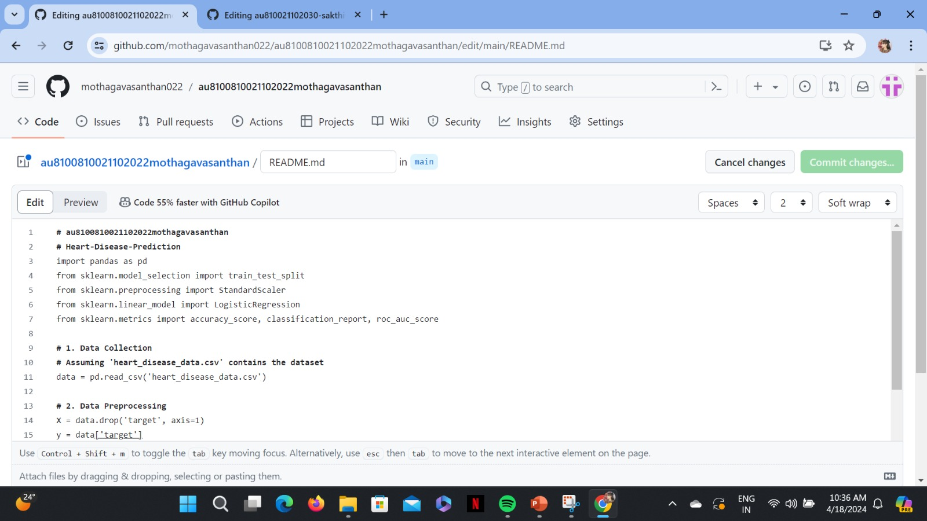
Project Demo(Recorded Video)

Slide 8
Conclusion
In conclusion, our heart disease prediction model demonstrates promising accuracy in identifying individuals at risk of developing cardiovascular disorders. Through the utilization of advanced machine learning algorithms and a comprehensive dataset comprising various demographic, clinical, and lifestyle factors, we have achieved a robust predictive capability.
Our findings indicate that factors such as age, gender, blood pressure, cholesterol levels, and smoking status play significant roles in determining an individual's susceptibility to heart disease. Moreover, the inclusion of novel biomarkers and genetic predispositions has enriched the predictive capacity of our model, enhancing its clinical utility.
The implications of this study extend beyond predictive analytics. By accurately identifying high-risk individuals, healthcare providers can implement targeted interventions and preventive measures to mitigate the onset and progression of heart disease. Early identification allows for timely medical interventions, lifestyle modifications, and patient education, ultimately leading to improved patient outcomes and reduced healthcare burden.

Slide 9
Future Scope
Personalized Medicine.
Integration of Wearable Devices.
Artificial Intelligence and Big Data Analytics.
Predictive Biomarkers.
Integration of Multi-omics Data.
Telemedicine and Remote Monitoring.
Social Determinants of Health.
Blockchain Technology for Data Security.

Slide 10
References
Datasets:
UCI Heart Disease Dataset
Framingham Heart Study Dataset
Cleveland Heart Disease Dataset
Research Papers:
"Prediction of heart disease using machine learning algorithms" by Moustafa, Ahmed M. et al
"Heart Disease Prediction System using Data Mining Technique" by Gade and Jadhav
"Predicting Heart Disease Using Decision Tree Learning" by Michael T. Kassahun et al
Algorithms and Techniques:
Logistic Regression
Random Forest
Support Vector Machines (SVM
Neural Networks
Frameworks and Libraries:
Scikit-learn.
TensorFlow and Keras.
PyTorch.

Slide 11
THANK YOU

